Slide 1
Microsoft Azure Security – Open Hack
Subtitle or speaker name

Slide 2

Module 02: Implement Platform Protection
Perimeter Security
Network Security
Host Security
Container Security
Module Labs

Slide 3
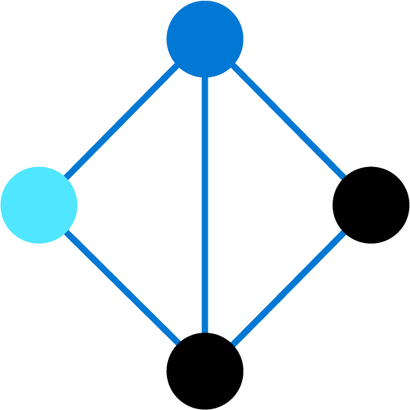
Perimeter Security

Slide 4


Perimeter Security
Defense in Depth
Virtual Network Security
Distributed Denial of Service (DDoS)
DDoS Implementation
Azure Firewall Features
Azure Firewall Implementation
VPN Forced Tunneling
UDRs and NVAs
Notes:
Implement platform protection (15-20%)
Implement advanced network security
Secure the connectivity of virtual networks
Create and configure Azure Firewall
Configure a firewall on a storage account, Azure SQL, KeyVault, or App Service
Implement DDoS

Slide 5
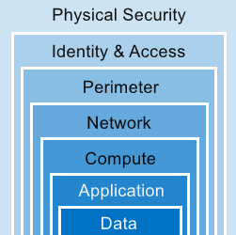
Defense in Depth
Privileged Identity Management
Conditional Access
DDoS
Azure Firewall
Network Security Groups
Application Security Groups
Network Micro-Segmentation
Host Security
(Lesson 02)
Advanced Data Security
Container Security (Lesson 03)
Provide a layered approach and multiple levels of protection
Notes:
This is conceptual, to be kept high level, explaining how security options can be targeted at each layer. We will discuss two layers in more depth in the next slide.
The previous slide outlined “the defense in depth” layered approach. This slide uses the Perimeter and Networking layers as examples. Discussing Azure networking security solutions at each layer is beyond the scope of this course.
Combining services :
Azure Firewall complements the functionality of Azure Network Security Groups (NSG). Together, they provide robust “defense in depth” network security. Network Security Groups add distributed, network layer, traffic filtering to protect traffic between resources, on virtual networks, within an Azure subscription.
Azure Firewall is a fully stateful, centralized, network Firewall-as-a-Service, which provides network and application-level protection across different subscriptions and virtual networks.
WAF is a feature of Application Gateway. It provides web applications with centralized, inbound, protection against exploits and vulnerabilities. Combining WAF with Azure Firewall adds layers of protection. Azure Firewall provides
inbound protection for non-HTTP/S protocols (for example, RDP, SSH, FTP).
outbound network-level protection for all ports and protocols.
application-level protection for outbound HTTP/S.
Data - AIP Azure Information Protection
Talked about in other lessons
Compute – Host Security
Application – Code Quality, Application authentication/authorization

Slide 6

Virtual Network Security
Virtual Networks
Dynamic and reserved public IP addresses
Direct virtual machine access
Load balancing
DNS hosting
Traffic management
DDoS protection
Bring your own network
Segment with subnets
Add network security groups
Create user defined routes
Point-to-site for dev/test
VPN Gateways for site-to-site
ExpressRoute for private connects
Notes:
Use this slide as a guide to discuss network security on premises vs in the cloud.
Whiteboard a solution together with your students.
Use the following questions as a guide.
Keep the focus on Security and relate the solution to Azure services and structures.
What does a network look like on-premises ?
How do we secure traffic coming into our network ?
How do we separate our applications ?
How do we separate Dev/Test and Production ?
How do we protect internet facing applications ?
What do we do to protect DDOS attacks ?
How do we manage DNS ?
How do we balance our traffic between multiple servers ?

Slide 7
Distributed Denial of Service (DDoS)
The goal of a DoS (Denial of Service) attack is to prevent access to services or systems.
Botnets are collections of internet-connected systems that an individual controls and uses without their owners’ knowledge
Bot
Bot
Target
DDoS is a collection of attack types aimed at disrupting the availability of a target
Bot
Bot
DDoS involves many systems sending traffic to targets as part of a botnet
Bot
Notes:
Cloud Provider DDoS attacks - https://www.microsoft.com/securityinsights/DDoS
A denial of service attack (DoS) is an attack that has the goal of preventing access to services or systems. If the attack originates from one location, it is called a DoS. If the attack originates from multiple networks and systems, it is called distributed denial of service (DDoS).
Before learning more about DDoS, you need to know what botnets are. Botnets are collections of internet-connected systems that an individual controls and uses without their owners’ knowledge. Botnet owners use them to perform various actions of their choosing. Often, they use them for spamming, data storage, DDoS, or various other actions that are up to the person in control of the botnet. In the past, botnets were made up just of compromised computers, but now, botnets are also made up of Internet of Things (IoT) devices. Malicious hackers can get these poorly secured security cameras, digital video recorders, thermostats, and other internet-connected devices under their control.
So, DDoS is a collection of attack types aimed at disrupting the availability of a target. These attacks involve a coordinated effort that uses multiple internet-connected systems to launch many network requests against DNS, web services, email, and more. Pretty much any application that the malicious hacker can access might become the target of a DDoS. The malicious hacker’s goal is to overwhelm system resources on targeted servers so they can no longer process legitimate traffic, effectively making the system inaccessible.
A DDoS generally involves many systems sending traffic to targets as part of a botnet. In most cases, the owners of the systems in a botnet don’t know that their devices are compromised and participating in an attack. Botnets are becoming a bigger problem than before because of the increasing numbers of connected devices.

Slide 8
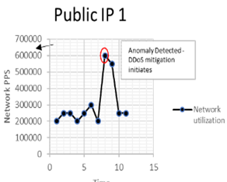
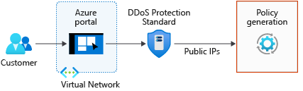
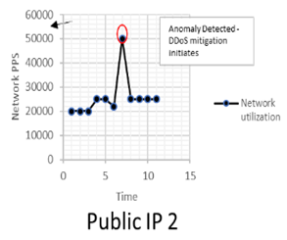
DDoS Implementation
Basic and Standard (multiple subscriptions) service tiers
Mitigates volumetric attacks, protocol attacks, and application layer attacks
Checks for malformed packets and spoofing
Notes:
Azure DDoS Protection Standard overview - https://docs.microsoft.com/en-us/azure/virtual-network/ddos-protection-overview
Azure DDoS Protection combined with application design best practices helps defend against DDoS. Azure DDoS Protection provides the following service tiers:
Basic. This service tier is automatically enabled as part of the Azure platform. It includes always-on traffic monitoring and the real-time mitigation of common network-level attacks, providing the same defenses that Microsoft Online Services uses. The entire scale of the Azure global network can be used to distribute and mitigate attack traffic across regions. This service tier provides powerful protection for Internet Protocol version 4 (IPv4) and Internet Protocol version 6 (IPv6) Azure public IP addresses.
Standard. This service tier provides additional mitigation capabilities over the Basic service tier that are tuned specifically to Azure Virtual Network resources. DDoS Protection Standard is simple to enable and requires no application changes. Protection policies are tuned through dedicated traffic monitoring and machine learning algorithms. Policies are applied to public IP addresses associated to resources deployed in virtual networks, such as Azure Load Balancer, Azure Application Gateway, and Azure Service Fabric instances, but this protection doesn’t apply to Azure App Service Environment. Azure Monitor views make real-time telemetry available during an attack and for history. Rich attack mitigation analytics are available via diagnostic settings. You can add application layer protection through the Azure Application Gateway WAF or by installing a third-party firewall from Azure Marketplace. This service tier helps protect IPv4 Azure public IP addresses.

Slide 9
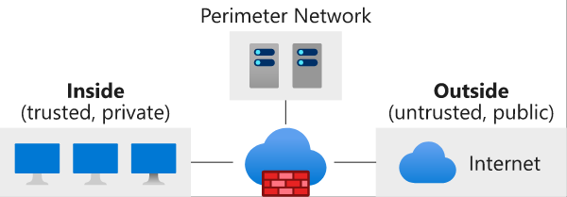
Azure Firewall
Managed, cloud-based network security service
Stateful firewall as a service
Integrated with Azure Monitor
Protects your Azure Virtual Network resources
Built-in high availability
Support for hybrid connectivity with gateways
Notes:
What is Azure Firewall - https://docs.microsoft.com/en-us/azure/firewall/overview
Some of the key features of Azure Firewall are:
Built-in high availability. You don’t need additional load balancers.
Unrestricted cloud scalability. You don’t need to budget for peak traffic times.
Application FQDN filtering rules. You can limit outbound HTTP and HTTPS traffic to a specified list of FQDNs, including wildcards. This feature doesn’t require SSL termination.
Network traffic filtering rules. You can centrally create allow or deny network filtering rules by source and destination IP addresses, port, and protocol. Azure Firewall is fully stateful, so it can distinguish legitimate packets for different types of connections. It enforces and logs rules across multiple subscriptions and virtual networks.
FQDN tags. FQDN tags make it easy for you to allow well-known Azure service network traffic through your firewall. For example, if you want to allow Windows Update network traffic through your firewall, you create an application rule and include the Windows Update tag. Then, network traffic from Windows Update can flow through your firewall.
Outbound SNAT support. SNAT translates all outbound virtual network traffic IP addresses to the Azure Firewall public IP address. You can identify and allow traffic originating from your virtual network to remote internet destinations.
Inbound Destination Network Address Translation (DNAT) support. DNAT translates inbound network traffic to your firewall public IP address and filters that traffic to the private IP addresses in your virtual networks.
Azure Monitor logging. All events are integrated with Azure Monitor, allowing you to archive logs to a storage account, stream events to your event hub, or send events to Azure Monitor logs.

Slide 10
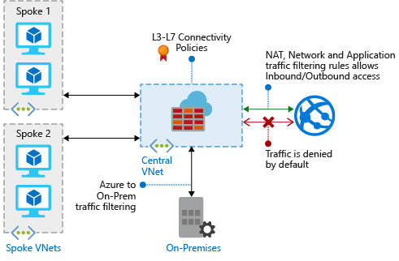
Azure Firewall Implementation
Application FQDN filtering rules
Network traffic filtering rules
FQDN tags
Outbound SNAT
Inbound DNAT support
L3-L7 connectivity policies
Separate firewall subnet
Static public IP address
Notes:
What is Azure Firewall - https://docs.microsoft.com/en-us/azure/firewall/overview

Slide 11
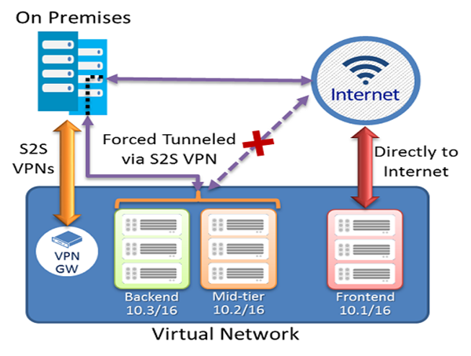
VPN Forced Tunneling
Redirect internet-bound traffic back to the company’s on-premises infrastructure for inspection and auditing
Internet-bound traffic from VMs always traverses from Azure network infrastructure directly out to the internet, without inspection or audit
Notes:
Configure Forced Tunneling - https://docs.microsoft.com/en-us/azure/vpn-gateway/vpn-gateway-forced-tunneling-rm
Forced tunneling lets you redirect or "force" all Internet-bound traffic back to your on-premises location via a Site-to-Site VPN tunnel for inspection and auditing. This is a critical security requirement for most enterprise IT policies.
Without forced tunneling, Internet-bound traffic from your VMs in Azure always traverses from Azure network infrastructure directly out to the Internet, without the option to allow you to inspect or audit the traffic. Unauthorized Internet access can potentially lead to information disclosure or other types of security breaches.
In the example on the slide, the front-end subnet doesn’t use forced tunneling. The workloads in the front-end subnet can continue to accept and respond to customer requests that come directly from the internet. The mid-tier and back-end subnets use forced tunneling. Any outbound connections from these two subnets to the internet are forced back to an on-premises site via one of the S2S VPN tunnels.

Slide 12
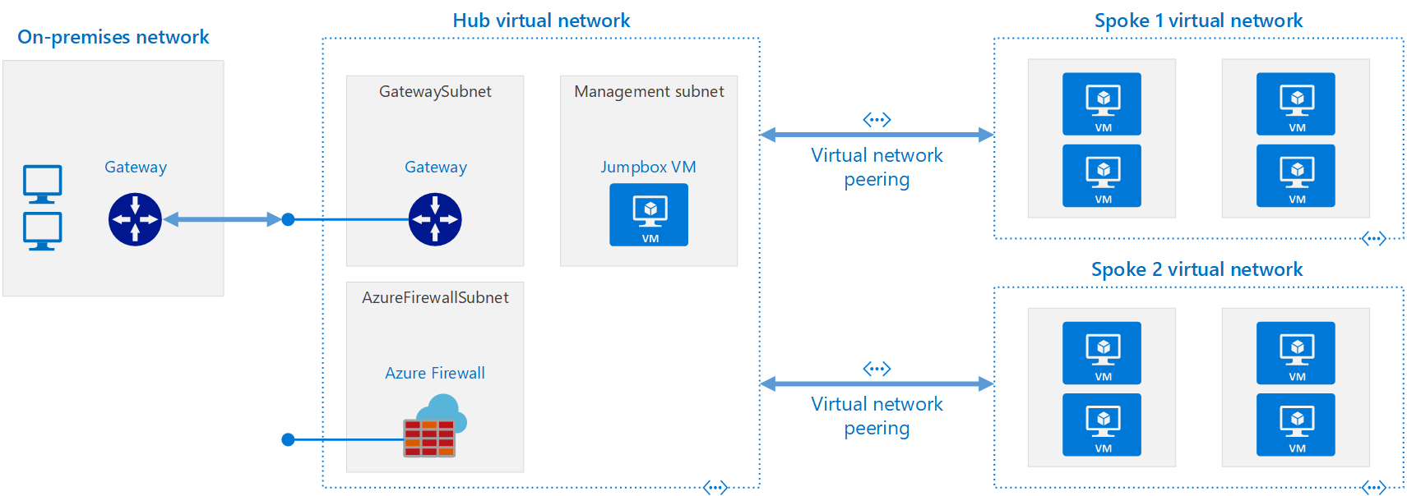
Hub and Spoke topology with Azure
Hub is a virtual network in Azure that acts as a central point of connectivity to your on-premises network.
Spokes are virtual networks that peer with the hub, and can be used to isolate workloads.
Notes:
The architecture consists of the following components.
On-premises network - A private local-area network running within an organization.
VPN device - A device or service that provides external connectivity to the on-premises network. The VPN device may be a hardware device, or a software solution such as the Routing and Remote Access Service (RRAS) in Windows Server 2012. For a list of supported VPN appliances and information on configuring selected VPN appliances for connecting to Azure, see About VPN devices for Site-to-Site VPN Gateway connections.
VPN virtual network gateway or ExpressRoute gateway - The virtual network gateway enables the virtual network to connect to the VPN device, or ExpressRoute circuit, used for connectivity with your on-premises network. For more information, see Connect an on-premises network to a Microsoft Azure virtual network.
Hub virtual network - The virtual network used as the hub in the hub-spoke topology. The hub is the central point of connectivity to your on-premises network, and a place to host services that can be consumed by the different workloads hosted in the spoke virtual networks.
Gateway subnet - The virtual network gateways are held in the same subnet.
Spoke virtual networks - One or more virtual networks that are used as spokes in the hub-spoke topology. Spokes can be used to isolate workloads in their own virtual networks, managed separately from other spokes. Each workload might include multiple tiers, with multiple subnets connected through Azure load balancers. For more information about the application infrastructure, see Running Windows VM workloads and Running Linux VM workloads.
Virtual network peering - Two virtual networks can be connected using a peering connection. Peering connections are non-transitive, low latency connections between virtual networks. Once peered, the virtual networks exchange traffic by using the Azure backbone, without the need for a router. In a hub-spoke network topology, you use virtual network peering to connect the hub to each spoke. You can peer virtual networks in the same region, or different regions. For more information, see Requirements and constraints.

Slide 13
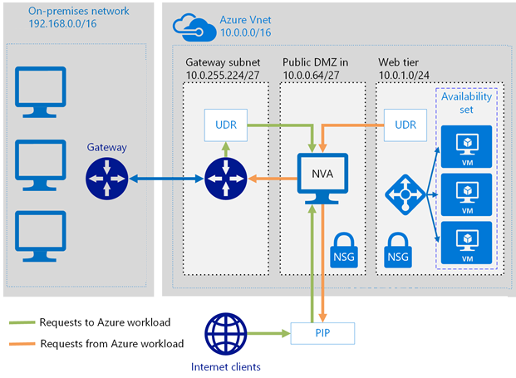
User Defined Routes and Network Virtual Appliances
UDRs override the default system routes and are associated with a subnet
NVAs control the flow of network traffic from one network to another
Notes:
Virtual network traffic routing - https://docs.microsoft.com/en-us/azure/virtual-network/virtual-networks-udr-overview
Deploy highly available network virtual appliances - https://docs.microsoft.com/en-us/azure/architecture/reference-architectures/dmz/nva-ha
In this architecture, the NVA provides a secure network boundary by checking all inbound and outbound network traffic and passing only the traffic that meets network security rules. However, the fact that all network traffic must pass through the NVA means that the NVA is a single point of failure in the network. If the NVA fails, there is no other path for network traffic and all the back-end subnets are unavailable.

Slide 14
Demonstration: Perimeter Security
VNet Peering
Azure Firewall
Notes:
In the virtual classroom consider having the students join you in doing the demonstrations. Or you could have someone share their screen and be coached through the demonstration. Consider which demonstrations to provide given your student’s interests and the labs they will be assigned.

Slide 15
Additional Study – Perimeter Security
Module Review Questions
Microsoft Learn Modules (docs.microsoft.com/Learn)
Fundamentals of network security
Fundamentals of computer networking
Manage and control traffic flow in your Azure deployment with routes (Exercise)
Distribute your services across Azure virtual networks and integrate them by using virtual network peering (Exercise)
Microsoft Azure Well-Architected Framework – Security
Configure the network for your virtual machines (Exercise)
Notes:
For students who may be new to Azure or are struggling with the labs consider having them use their lab time going through the Learn modules instead.
(docs.microsoft.com/Learn)
Fundamentals of Computer Networking – https://docs.microsoft.com/en-us/learn/modules/network-fundamentals/
Fundamentals of Network Security – https://docs.microsoft.com/en-us/learn/modules/network-fundamentals-2/
Manage and control traffic flow in your Azure deployment with routes – https://docs.microsoft.com/en-us/learn/modules/control-network-traffic-flow-with-routes/
Distribute your services across Azure virtual networks and integrate them by using virtual network peering - https://docs.microsoft.com/en-us/learn/modules/integrate-vnets-with-vnet-peering/
Microsoft Azure Well-Architected Framework (Security) - https://docs.microsoft.com/en-us/learn/modules/azure-well-architected-security/
Configure the network for your virtual machines - https://docs.microsoft.com/en-us/learn/modules/configure-network-for-azure-virtual-machines/

Slide 16
Network Security

Slide 17




Network Security
Network Security Groups (NSG)
NSG Implementation
Application Security Groups
Service Endpoints
Private Endpoints
Azure Application Gateway
Web Application Firewall
Azure Front Door
ExpressRoute
Notes:
Implement platform protection (15-20%)
Implement advanced network security
Secure the connectivity of virtual networks
Configure Network Security Groups (NSGs) and Application Security Groups (ASGs)
Configure Azure Front Door service as an Application Gateway
Configure a Web Application Firewall (WAF) on Azure Application Gateway
Implement Service Endpoints

Slide 18
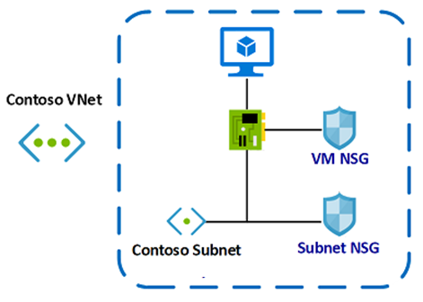
Network Security Groups (NSG)
Limit virtual network traffic
Can be associated to a subnet or a network interface
Uses security rules to allow or deny network traffic
Default inbound and outbound rules allow virtual network and load balancers – all other traffic denied
Notes:
Network Security Groups - https://docs.microsoft.com/en-us/azure/virtual-network/security-overview#network-security-groups

Slide 19
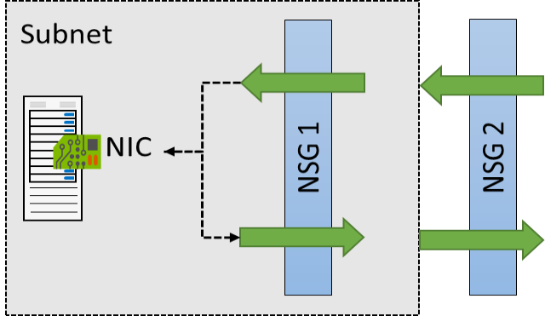
NSG Implementation
NSGs are evaluated independently for the subnet and NIC
An “allow” rule must exist at both levels for traffic to be admitted
You can add more rules – many preconfigured selections (SSH, RDP, FTP… )
Troubleshoot with the Effective Security Rules link
Notes:
Network Security Groups - https://docs.microsoft.com/en-us/azure/virtual-network/security-overview#network-security-groups
To simplify management of security rules, it's recommended that you associate a network security group to individual subnets, rather than individual network interfaces within the subnet.
Security rules in NSGs enable you to filter network traffic that can flow in and out of virtual network subnets and network interfaces.
There are default security rules. You cannot delete the default rules, but you can add other rules with a higher priority.

Slide 20
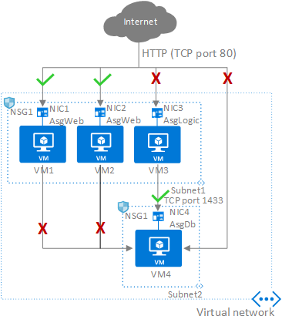
Application Security Groups (ASGs)
Extends your application's structure
ASGs logically group virtual machines – web servers, application servers
Define rules to control the traffic flow
Wrap the ASG with an NSG for added security
Notes:
NIC1 and NIC2 are members of the AsgWeb application security group.
NIC3 is a member of the AsgLogic application security group.
NIC4 is a member of the AsgDb application security group.
None of the network interfaces have an associated network security group.
NSG1 is associated to both subnets and contains the following rules:
Allow-HTTP-Inbound-Internet
Deny-Database-All
Allow-Database-BusinessLogic
The rules that specify an ASG as the source or destination are only applied to the network interfaces that are members of the ASG. If the network interface is not a member of an ASG, the rule is not applied to the network interface even though the network security group is associated to the subnet.
Summary
Application Security Groups along with NSGs, have brought multiple benefits on the network security area:
A single management experience
Increased limits on multiple dimensions
A great level of simplification
A seamless integration with your architecture

Slide 21
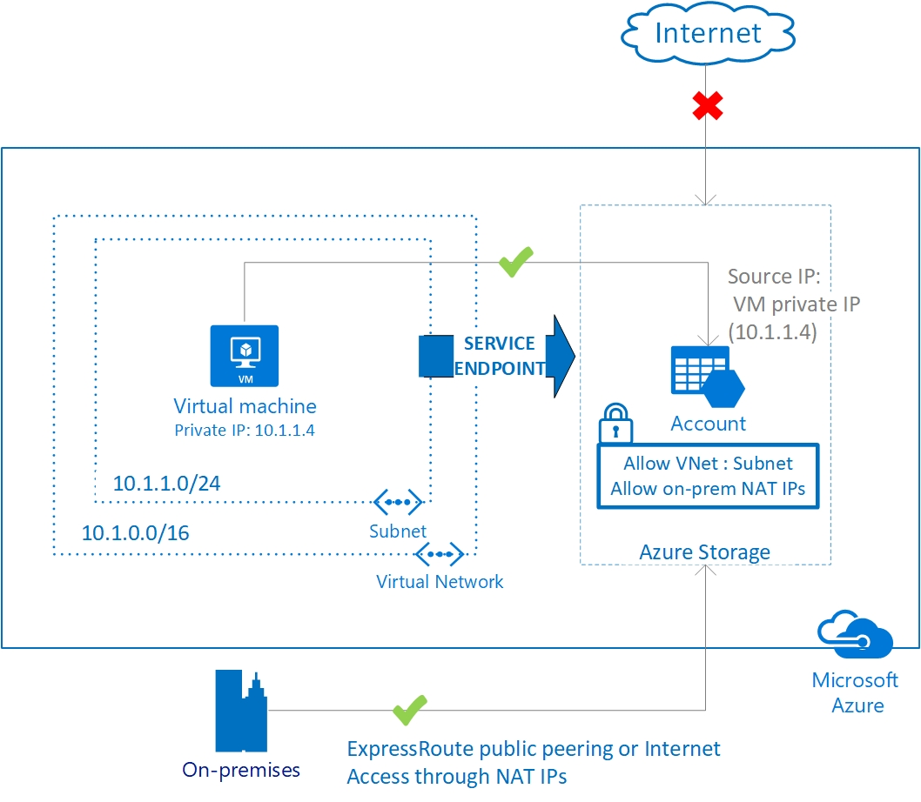
Service Endpoints
Endpoints limit network access to specific subnets and IP addresses
Improved security for your Azure service resources
Optimal routing for Azure service traffic from your virtual network
Endpoints use the Microsoft Azure backbone network
Simple to set up with less management overhead
Notes:
Virtual network service endpoints - https://docs.microsoft.com/en-us/azure/virtual-network/virtual-network-service-endpoints-overview

Slide 22
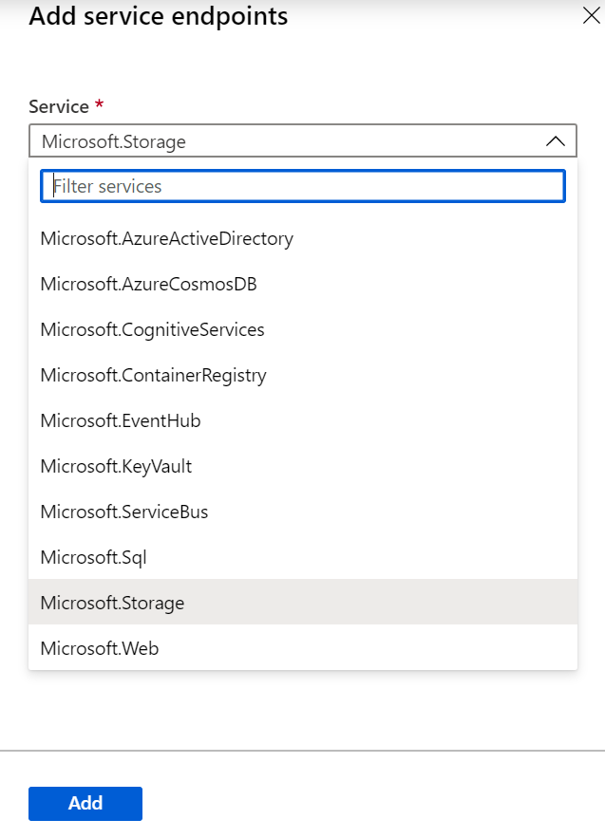
Service Endpoint Services
✔️ Adding service endpoints can take up to 15 minutes to complete
Notes:
Virtual network service endpoints - https://docs.microsoft.com/en-us/azure/virtual-network/virtual-network-service-endpoints-overview

Slide 23
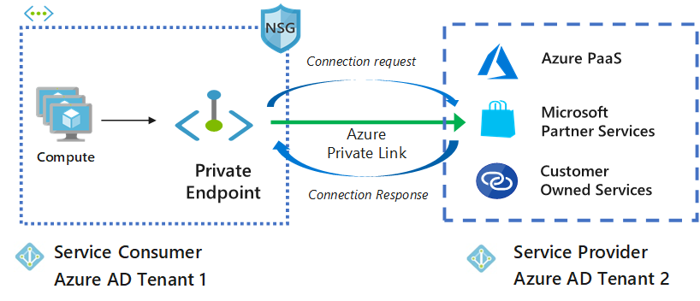
Private Endpoint
Private connectivity to services on Azure
Integration with on-premises and peered networks
Traffic remains on the Microsoft network, with no public internet access
In the event of a security incident within your network, only the mapped resource would be accessible
Notes:
What is Azure Private Link - https://docs.microsoft.com/en-us/azure/private-link/private-link-overview
Azure Private Link works on an approval call flow model wherein the Private Link service consumer can request a connection to the service provider for consuming the service. The service provider can then decide whether to allow the consumer to connect or not. Azure Private Link enables the service providers to manage the private endpoint connection on their resources.

Slide 24
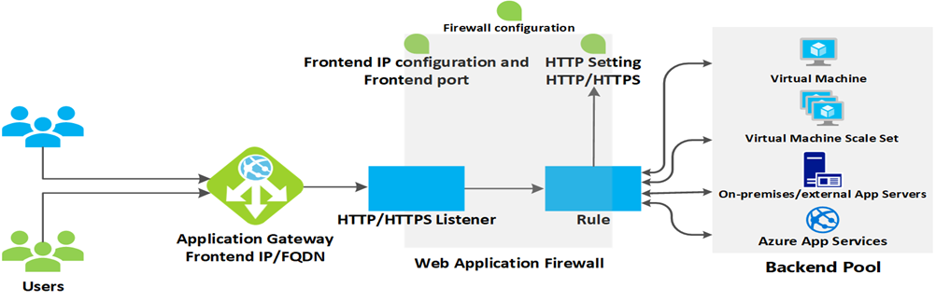
Azure Application Gateway
Websocket and HTTP/2 traffic
Custom error pages
Rewrite HTTP headers
Secure Sockets Layer (SSL/TLS) termination
Multiple site hosting
URL based routing
Path-based redirection
Session affinity
Connection draining
Notes:
What is Azure Application Gateway? https://docs.microsoft.com/en-us/azure/application-gateway/log-analytics

Slide 25
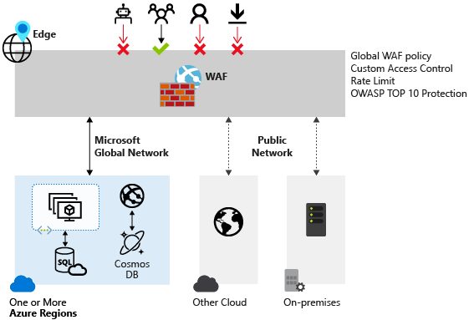
Web Application Firewall
Protects against cross site scripting and SQL injection
OWASP Core Rule sets 3.1, 3.0, 2.29
Custom access control
Supports Azure Front Door, Azure Application Gateway, and CDN (preview)
Notes:
https://docs.microsoft.com/en-us/azure/application-gateway/features#web-application-firewall
https://docs.microsoft.com/en-us/azure/web-application-firewall/overview
Web Application Firewall (WAF) provides centralized protection of your web applications from common exploits and vulnerabilities. Web applications are increasingly targeted by malicious attacks that exploit commonly known vulnerabilities. SQL injection and cross-site scripting are among the most common attacks.

Slide 26
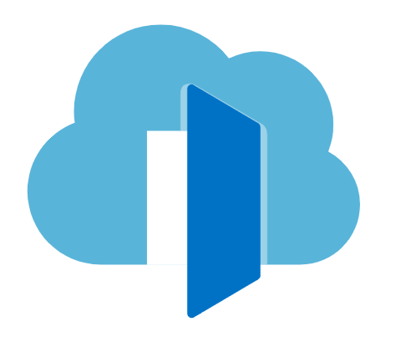
Azure Front Door
Layer 7 global routing
Accelerate application performance with anycast and split TCP
URL-based routing and session affinity
Multiple-site hosting
Custom domains and certificate management
Application layer security - WAF
URL redirection and URL rewrite
Protocol support - IPv6 and HTTP/2 traffic
Notes:
https://docs.microsoft.com/en-us/azure/frontdoor/front-door-overview
One way to protect an Azure service is to make it highly available, very responsive, and monitor its performance for unresponsiveness. Azure Front Door Service (AFD) offers these protections.
AFD enables you to define, manage, and monitor the global routing for your web traffic by optimizing for best performance and instant global failover for high availability. With AFD, you can transform your multiple-region consumer and enterprise applications into robust, high-performance, personalized modern applications, APIs, and content that reaches a global audience with Azure.
AFD works at Layer 7 or HTTP/HTTPS layer, and uses anycast protocol with split TCP and Microsoft's global network for improving global connectivity. Based on your routing method selection in the configuration, you can ensure that AFD is routing your client requests to the fastest and most available application backend. An application backend is any internet-facing service hosted inside or outside of Azure.
AFD provides a range of traffic-routing methods and backend health monitoring options to suit different application needs and automatic failover models. Similar to Traffic Manager, AFD is resilient to failures, including an entire Azure region failure. AFD is not a new service; it was developed years ago to enhance its Bing and Microsoft Office 365 services.
As you present this slide, demonstrate the process of provisioning and configuring Azure Front Door service.
https://docs.microsoft.com/en-us/azure/frontdoor/front-door-overview
One way to protect an Azure service is to make it highly available, very responsive, and monitor its performance for unresponsiveness. Azure Front Door Service (AFD) offers these protections.
AFD enables you to define, manage, and monitor the global routing for your web traffic by optimizing for best performance and instant global failover for high availability. With AFD, you can transform your multiple-region consumer and enterprise applications into robust, high-performance, personalized modern applications, APIs, and content that reaches a global audience with Azure.
AFD works at Layer 7 or HTTP/HTTPS layer, and uses anycast protocol with split TCP and Microsoft's global network for improving global connectivity. Based on your routing method selection in the configuration, you can ensure that AFD is routing your client requests to the fastest and most available application backend. An application backend is any internet-facing service hosted inside or outside of Azure.
AFD provides a range of traffic-routing methods and backend health monitoring options to suit different application needs and automatic failover models. Similar to Traffic Manager, AFD is resilient to failures, including an entire Azure region failure. AFD is not a new service; it was developed years ago to enhance its Bing and Microsoft Office 365 services.
As you present this slide, demonstrate the process of provisioning and configuring Azure Front Door service.

Slide 27
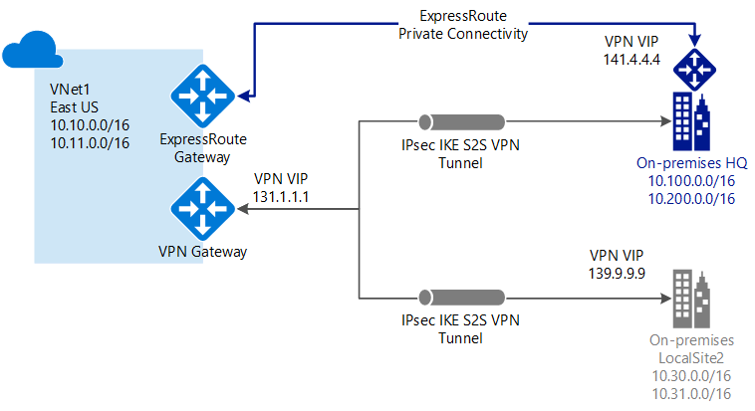
ExpressRoute Direct
Layer 3 connectivity with redundancy
Connectivity to all regions within a geography – global add-on
Private connections with high speed data ingestion
Billing models – unlimited, metered, premium
Notes:
ExpressRoute Overview - https://docs.microsoft.com/en-us/azure/expressroute/expressroute-introduction
ExpressRoute Direct gives you the ability to connect directly into Microsoft’s global network at peering locations strategically distributed across the world. ExpressRoute Direct provides dual 100 Gbps or 10 Gbps connectivity, which supports Active/Active connectivity at scale.
Key features that ExpressRoute Direct provides include, but aren't limited to:
Massive Data Ingestion into services like Storage and Cosmos DB
Physical isolation for industries that are regulated and require dedicated and isolated connectivity like: Banking, Government, and Retail
Granular control of circuit distribution based on business unit
ExpressRoute Direct supports massive data ingestion scenarios into Azure storage and other big data services. ExpressRoute circuits on 100 Gbps ExpressRoute Direct now also support 40 Gbps and 100 Gbps circuit SKUs. The physical port pairs are 100 or 10 Gbps only and can have multiple virtual circuits.
ExpressRoute Direct supports both QinQ and Dot1Q VLAN tagging.
QinQ VLAN Tagging allows for isolated routing domains on a per ExpressRoute circuit basis. Azure dynamically allocates an S-Tag at circuit creation and cannot be changed. Each peering on the circuit (Private and Microsoft) will utilize a unique C-Tag as the VLAN. The C-Tag is not required to be unique across circuits on the ExpressRoute Direct ports.
Dot1Q VLAN Tagging allows for a single tagged VLAN on a per ExpressRoute Direct port pair basis. A C-Tag used on a peering must be unique across all circuits and peerings on the ExpressRoute Direct port pair.
ExpressRoute Direct provides the same enterprise-grade SLA with Active/Active redundant connections into the Microsoft Global Network. ExpressRoute infrastructure is redundant and connectivity into the Microsoft Global Network is redundant and diverse and scales accordingly with customer requirements.
Point-to-point encryption by MACsec
MACsec is an IEEE standard. It encrypts data at the Media Access control (MAC) level or Network Layer 2. You can use MACsec to encrypt the physical links between your network devices and Microsoft's network devices when you connect to Microsoft via ExpressRoute Direct. MACsec is disabled on ExpressRoute Direct ports by default. You bring your own MACsec key for encryption and store it in Azure Key Vault. You decide when to rotate the key.
End-to-end encryption by IPsec and MACsec
IPsec is an IETF standard. It encrypts data at the Internet Protocol (IP) level or Network Layer 3. You can use IPsec to encrypt an end-to-end connection between your on-premises network and your virtual network (VNET) on Azure.
MACsec secures the physical connections between you and Microsoft. IPsec secures the end-to-end connection between you and your virtual networks on Azure. You can enable them independently.

Slide 28
Demonstrations: Network Connectivity
Network Security Groups
Application Security Groups
Notes:
In the virtual classroom consider having the students join you in doing the demonstrations. Or you could have someone share their screen and be coached through the demonstration. Consider which demonstrations to provide given your student’s interests and the labs they will be assigned.

Slide 29
Additional Study – Network Security
Module Review Questions
Microsoft Learn Modules (docs.microsoft.com/Learn)
Encrypt network traffic end to end with Azure Application Gateway (Exercise)
Connect your on-premises network to the Microsoft global network by using ExpressRoute
Design a hybrid network architecture on Azure
Secure and isolate access to Azure resources by using network security groups and service endpoints (Exercise)
Notes:
For students who may be new to Azure or are struggling with the labs consider having them use their lab time going through the Learn modules instead.
(docs.microsoft.com/Learn)
Encrypt network traffic end to end with Azure Application Gateway - https://docs.microsoft.com/en-us/learn/modules/end-to-end-encryption-with-app-gateway/
Connect your on-premises network to the Microsoft global network by using ExpressRoute - https://docs.microsoft.com/en-us/learn/modules/connect-on-premises-network-with-expressroute/
Design a hybrid network architecture on Azure - https://docs.microsoft.com/en-us/learn/modules/design-a-hybrid-network-architecture/
Secure and isolate access to Azure resources by using network security groups and service endpoints - https://docs.microsoft.com/en-us/learn/modules/secure-and-isolate-with-nsg-and-service-endpoints/

Slide 30
Host Security

Slide 31

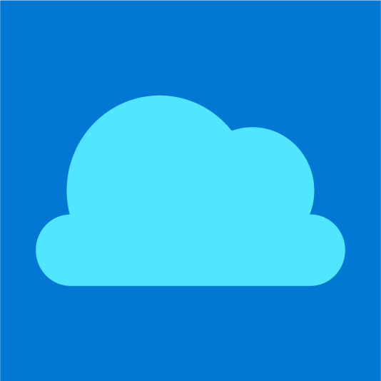


Host Security
Endpoint Protection
Privileged Access Workstations
Virtual Machine Templates
Remote Access Management
Update Management
Disk Encryption
Windows Defender
Security Center Recommendations
Securing Azure Workloads
Notes:
Implement platform protection (15-20%)
Implement advanced network security
Configure Azure Bastion
Configure advanced security for compute
Configure endpoint protection
Configure and monitor system updates for VMs
Implement Azure Disk Encryption
Configure automatic updates

Slide 32
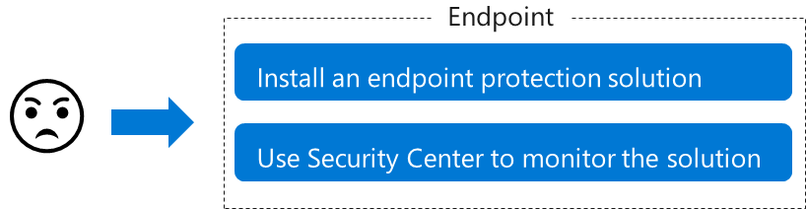
Endpoint Protection
Endpoint systems interact directly with users
Endpoint systems are typically vulnerable to security attacks
Azure Security Center provides the tools you need to harden your network, secure your services, and solidify your security posture
Notes:
Computer systems that interact directly with users are considered endpoint systems. Systems on devices, such as laptops, smartphones, tablets, and computers, all need to be secured to help prevent them from acting as gateways for security attacks on an organization’s networked systems.
Earlier, this module discussed the shared responsibilities of helping secure services in Azure. IaaS involves more customer responsibility than PaaS and SaaS did, and Azure Security Center provides the tools you need to harden your network, help secure your services, and stay on top of your security posture.
First step: Help protect against malware
Install antimalware to help identify and remove viruses, spyware, and other malicious software. You can install Microsoft Antimalware or an endpoint protection solution from a Microsoft Partner.
Next, integrate your antimalware solution with Azure Security Center to monitor the status of the antimalware protection. Security Center reports this on the Endpoint protection issues blade. Security Center highlights issues, such as detected threats and insufficient protection, which might make your VMs and computers vulnerable to malware threats. By using the information on Endpoint protection issues, you can make a plan to address any identified issues.
Azure Security Center monitors the status of antimalware protection and reports this on the Endpoint protection issues blade. Security Center notes issues, such as detected threats and insufficient protection, that might make your VMs and computers vulnerable to malware threats. By using the information on Endpoint protection issues, you can make a plan to address any identified issues.

Slide 33
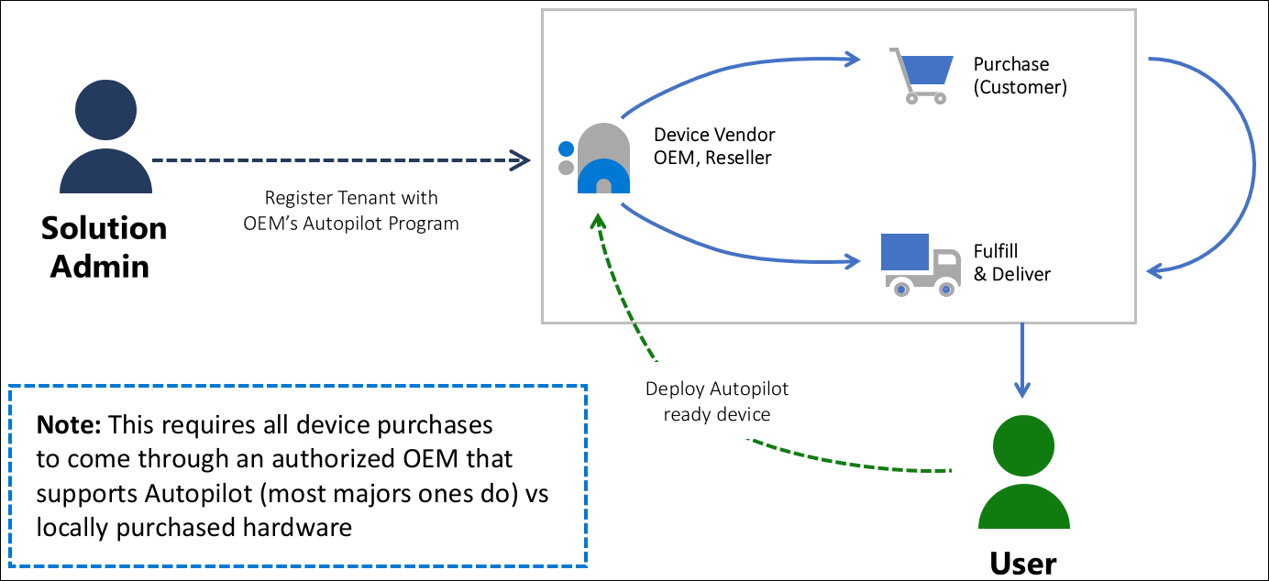
Privileged Access Device Strategy
Hardware Root-of-Trust
Trusted Platform Module (TPM) 2.0 BitLocker Drive Encryption UEFI Secure Boot Drivers and Firmware Distributed through Windows Update Virtualization and HVCI Enabled Drivers and Apps HVCI-Ready Windows Hello DMA I/O Protection System Guard Modern Standby
Secure from the OEM
Notes:
Why are privileged access devices important | Microsoft Docs
This guidance is part of a complete privileged access strategy and is implemented as part of the Privileged access deployment
End to end zero trust security for privileged access requires a strong foundation of device security upon which to build other security assurances for the session. While security assurances may be enhanced in the session, they will always be limited by how strong the security assurances are in the originating device. An attacker with control of this device can impersonate users on it or steal their credentials for future impersonation. This risk undermines other assurances on the account, intermediaries like jump servers, and on the resources themselves. For more information, see clean source principle
The article provides an overview of security controls to provide a secure workstation for sensitive users throughout its lifecycle.
Workflow to acquire and deploy a secure workstation
This solution relies on core security capabilities in the Windows 10 operating system, Microsoft Defender for Endpoints, Azure Active Directory, and Microsoft Intune.
Who benefits from a secure workstation?
All users and operators benefit from using a secure workstation. An attacker who compromises a PC or device can impersonate or steal credentials/tokens for all accounts that use it, undermining many or all other security assurances. For administrators or sensitive accounts, this allows attackers to escalate privileges and increase the access they have in your organization, often dramatically to domain, global, or enterprise administrator privileges.
For details on security levels and which users should be assigned to which level, see Privileged access security levels
Device Security Controls
The successful deployment of a secure workstation requires it to be part of an end to end approach including devices, accounts, intermediaries, and security policies applied to your application interfaces. All elements of the stack must be addressed for a complete privileged access security strategy.

Slide 34
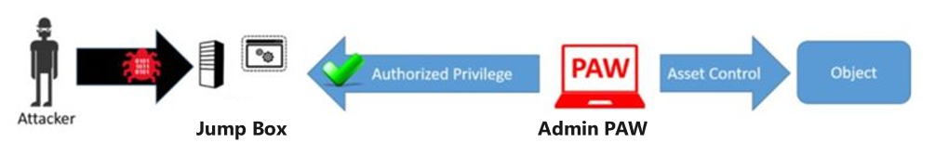
Privileged Access Workstations
Separate dedicated administrative accounts and workstations.
Protects from Internet attacks and threat vectors phishing attacks, application and OS vulnerabilities, and credential theft attack
Appropriate for accounts with access to high value assets -Administrators and High Sensitivity Information Workers
Notes:
Privileged Access Workstations - https://docs.microsoft.com/en-us/windows-server/identity/securing-privileged-access/privileged-access-workstationsRemind students about PAW concept and why it is recommended to use it in this scenario.
We recommend using Privileged Access Workstations (PAWs) and VPN when administering VMs in Azure. PAWs provide a dedicated operating system for sensitive tasks, with additional protection from internet attacks and threat vectors
Use a security-enhanced management workstation to help protect sensitive accounts, tasks, and data
PAWs reduce the attack surface of workstations. These security-enhanced management workstations can help you mitigate some of these attacks and make data safer.
Get powerful endpoint protection
Enforce security policies across all devices that are used to consume data, regardless of the data location (cloud or on-premises).

Slide 35
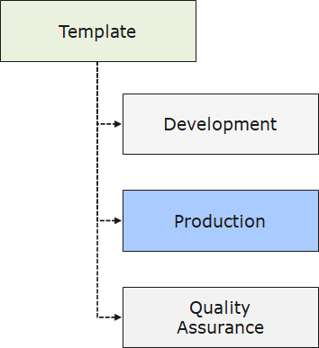
Virtual Machine Templates
Improves consistency
Express complex deployments
Reduce manual, error prone tasks
Express requirements through code
Promotes reuse
Modular and can be linked
Simplifies orchestration
Enforces security concerns
Notes:
What are ARM Templates - https://docs.microsoft.com/en-us/azure/azure-resource-manager/templates/overview
Before diving into configuring VM policies and templates, you need to understand the features and functionality of Azure Resource Manager.
Resource Manager is the deployment and management service for your Azure subscription. It provides a consistent management layer that allows you to create, update, and delete resources in your Azure subscription. You can use its access control, auditing, and tagging features to help secure and organize your resources after deployment.
When you take actions through the portal, Azure PowerShell, the Azure CLI, REST APIs, or client SDKs, the Resource Manager API handles your request. Because the same API handles all requests, you get consistent results and capabilities in all the different tools. The figure on the slide depicts this point. Some additional terms to know when using ARM:
resource provider - A service that supplies Azure resources. For example, a common resource provider is Microsoft.Compute, which supplies the virtual machine resource. Microsoft.Storage is another common resource provider.
Resource Manager template - A JavaScript Object Notation (JSON) file that defines one or more resources to deploy to a resource group or subscription. The template can be used to deploy the resources consistently and repeatedly.
declarative syntax - Syntax that lets you state "Here is what I intend to create" without having to write the sequence of programming commands to create it. The Resource Manager template is an example of declarative syntax. In the file, you define the properties for the infrastructure to deploy to Azure.

Slide 36
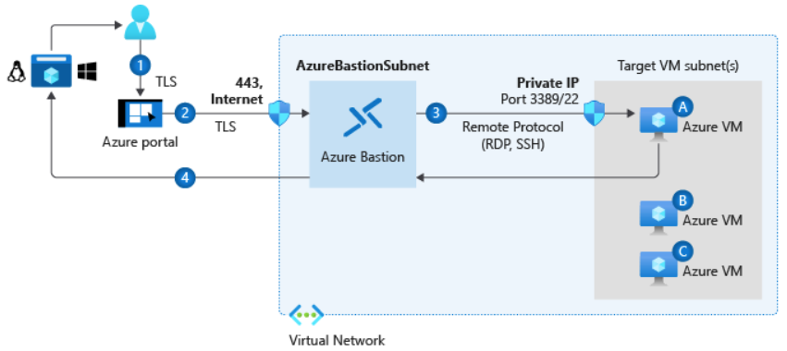
Remote Access Management
Remote Desktop Protocol (RDP) for Windows-based virtual machines
Secure Shell Protocol (SSH) for Linux based virtual machines
Bastion Subnet for RDP/SSH through the Portal over SSL
Notes:
Connect to your Azure-based virtual machine - https://docs.microsoft.com/en-us/azure/marketplace/cloud-partner-portal/virtual-machine/cpp-connect-vm
What is Azure Bastion - https://docs.microsoft.com/en-us/azure/bastion/bastion-overview

Slide 37
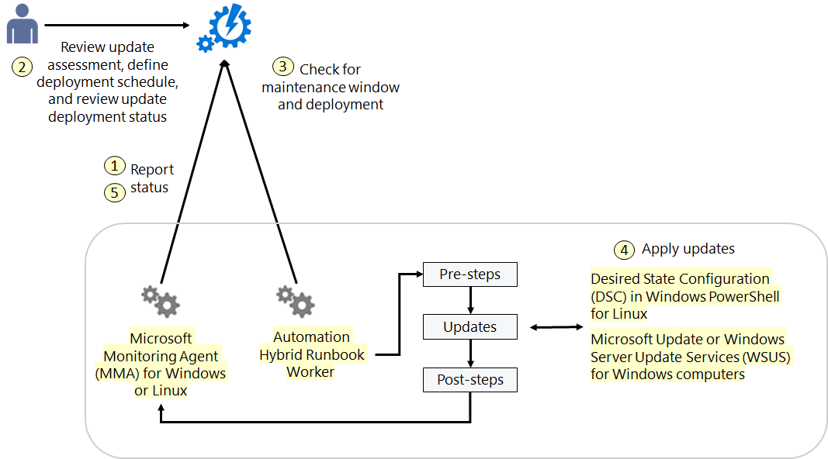
Update Management
Updates for Windows and Linux machines in Azure, in on-premises environments, and in other cloud environments.
Notes:
Update Management in Azure Automation - https://docs.microsoft.com/en-us/azure/automation/automation-update-management
Automate resources in your datacenter or cloud by using Hybrid Runbook Worker - https://docs.microsoft.com/en-us/azure/automation/automation-hybrid-runbook-worker

Slide 38
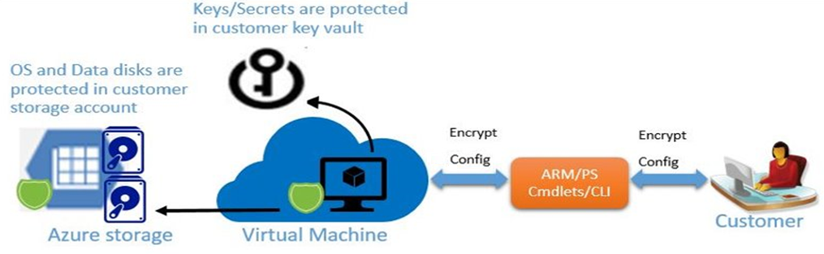
Disk Encryption
Provides encryption of the operating system and data disks
Windows VMs (BitLocker) and Linux VMs (DM-Crypt)
Stores encryption keys in a customer-managed key vault
Notes:
Azure Disk Encryption (Windows) - https://docs.microsoft.com/en-us/azure/virtual-machines/windows/disk-encryption-overview
Azure Disk Encryption (Linux) - https://docs.microsoft.com/en-us/azure/virtual-machines/linux/disk-encryption-overview
Azure Disk Encryption helps you encrypt your Windows IaaS and Linux IaaS VM disks. Disk Encryption uses the industry standard BitLocker feature of Windows, and the DM-Crypt feature of Linux to provide volume encryption for the OS and data disks. The solution is integrated with Azure Key Vault to help you control and manage the disk-encryption keys and secrets. The solution also ensures that all data on the VM disks are encrypted at rest in your Azure storage.
Disk Encryption for Windows IaaS and Linux VMs is in General Availability in all Azure public regions and Azure Government regions for Standard VMs and VMs with Azure Premium Storage.
Point out that if you use Azure Security Center, you're alerted if you have VMs that aren't encrypted. The alerts display as High Severity, and the recommendation is to encrypt these VMs.
Step through the implementation process and reference the image on this slide. Enabling disk encryption for Windows and Linux VMs, involves the following high-level steps:
1. Choose an encryption scenario from the scenarios listed in the Encryption scenarios section.
2. Enable disk encryption and specify the encryption configuration via Azure Disk Encryption Resource Manager template, PowerShell cmdlets, or Azure CLI
3. For the customer-encrypted VHD scenario, upload the encrypted VHD to your storage account and the encryption key material to your key vault. Then, provide the encryption configuration to enable encryption on a new IaaS VM.
4. For new VMs that you get from the Marketplace, and for existing VMs that already run in Azure, provide the encryption configuration to enable encryption on the IaaS VM.
5. Grant access to the Azure platform to read the encryption key material (BitLocker encryption keys for Windows systems and Passphrase for Linux) from your key vault to enable encryption on the IaaS VM.
Note that it is also possible to disable disk encryption by using the ARM templates, PowerShell, or Azure CLI.

Slide 39
Microsoft Defender
Platforms
Windows 7,8.1, and 10
Windows Server 2008, , 2012, 2016, 2019
Android
iOS
Linux
macOS
Windows Defender Credential Guard
Virtualization-based security to isolate secrets so that only privileged system software can access them
Windows Defender Application Control
Mitigate attacks from spyware, adware, rootkits, viruses, and keyloggers, by restricting the applications that users can run and the code that runs in the system core or kernel
Notes:
Reference?
There are key security features that are included with Windows 10, and Windows Server 2016, Windows Server 2019. They are Windows Defender Credential Guard, Device Guard, and Windows Defender Application Control.
Credential Guard uses virtualization-based security enhancement to isolate secrets so that only privileged system software can access them. Unauthorized access to these secrets might lead to credential theft attacks, such as Pass-the-Hash or pass-the-ticket attacks. Windows Defender Credential Guard helps prevent these attacks by helping protect Integrated Windows Authentication (NTLM) password hashes, Kerberos authentication ticket-granting tickets, and credentials that applications store as domain credentials.
The configuration state of Windows Defender Device Guard was originally designed with a specific security idea in mind. Although no direct dependencies existed between the two main OS features of the Windows Defender Device Guard configuration—that is, between configurable code integrity and Hypervisor-protected code integrity (HVCI)—the discussion intentionally focused on the Windows Defender Device Guard lockdown state that can be achieved when they’re deployed together.
Windows Defender Application Control helps mitigate these types of threats by restricting the applications that users can run and the code that runs in the system core, or kernel. Policies in Windows Defender Application Control also block unsigned scripts and MSIs, and Windows PowerShell runs in Constrained language mode.

Slide 40
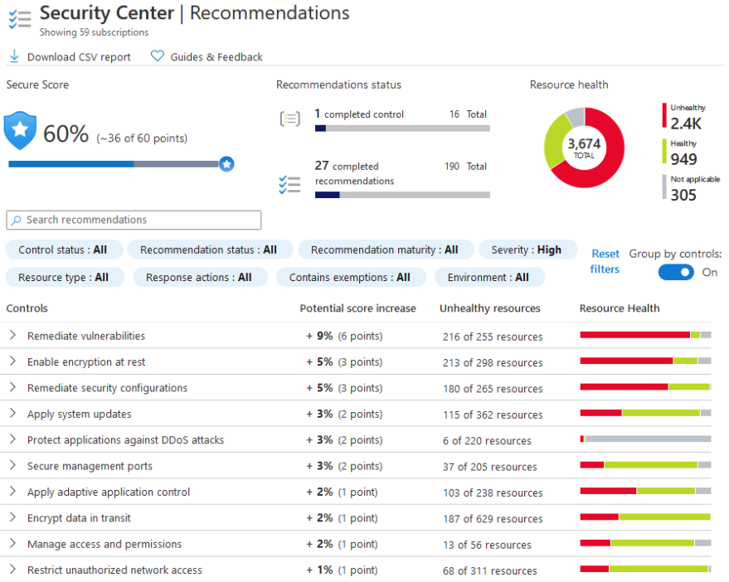
Security Center Recommendations
System security and critical update recommendations
Endpoint protection recommendations
Disk encryption validation
Vulnerability assessment and remediation
Threat detection
Notes:
Protect your machines and applications - https://docs.microsoft.com/en-us/azure/security-center/security-center-virtual-machine-protection
A security policy defines the set of controls which are recommended for resources within the specified subscription or resource group. Before enabling security policy, you must have data collection enabled, Security Center collects data from your virtual machines in order to assess their security state, provide security recommendations, and alert you to threats. In Security Center, you define policies for your Azure subscriptions or resource groups according to your company’s security needs and the type of applications or sensitivity of the data in each subscription.
Security Center analyzes the security state of your Azure resources. When Security Center identifies potential security vulnerabilities, it creates recommendations. The recommendations guide you through the process of configuring the needed controls.
After setting a security policy, Security Center analyzes the security state of your resources to identify potential vulnerabilities. The recommendations are shown in a table format where each line represents one recommendation. ASC will monitor and analyze the enable security policies to identify potential vulnerabilities.

Slide 41
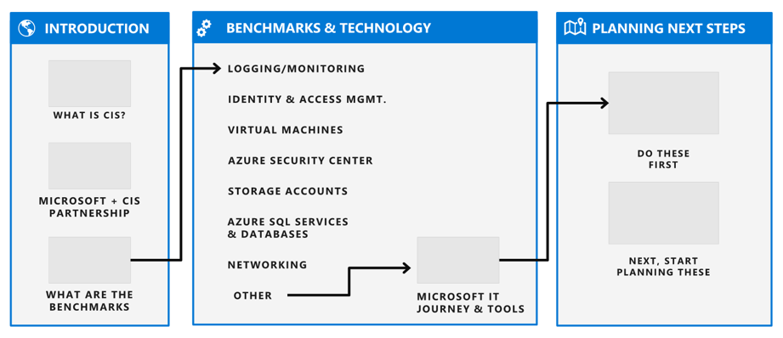
Securing Azure Workloads
CIS best practices to establish security baselines
Recommendations are divided into categories
Two levels (minimum and highly secure)
Notes:
Center for Internet Security (CIS) Benchmarks - https://azure.microsoft.com/resources/cis-microsoft-azure-foundations-security-benchmark
Microsoft's cybersecurity group in conjunction with the Center for Internet Security (CIS) developed best practices to help establish security baselines for the Azure platform.
Microsoft initially partnered with CIS for the development of an off-the-shelf hardened Azure VM. An initiative then began to use the CIS Benchmarks (their term for best practices) with Azure sec
Level 1:
Ensure that OS disk are encrypted
Ensure only approved extensions are installed
Ensure that the OS patches for the VMs are applied

Slide 42
Demonstrations: Host Security
Bastion connections
Virtual machine updates
Virtual machine extensions
Disk encryption
RDP to Windows VMs (optional)
SSH to Linux VMs (optional)
Notes:
In the virtual classroom consider having the students join you in doing the demonstrations. Or you could have someone share their screen and be coached through the demonstration. Consider which demonstrations to provide given your student’s interests and the labs they will be assigned.

Slide 43
Additional Study – Host Security
Module Review Questions
Microsoft Learn Modules (docs.microsoft.com/Learn)
Build Azure Resource Manager templates (Exercise)
Secure your Azure virtual machine disks (Exercise)
Protect against threats with Microsoft Defender for Endpoint
Introduction to Azure virtual machines (Exercise)
Keep your virtual machines updated (Exercise)
Create a Windows virtual machine in Azure (Exercise)
Create a Linux virtual machine in Azure (Exercise)
Security baselines
Notes:
For students who may be new to Azure or are struggling with the labs consider having them use their lab time going through the Learn modules instead.
(docs.microsoft.com/Learn)
Build Azure Resource Manager templates - https://docs.microsoft.com/en-us/learn/modules/build-azure-vm-templates/
Secure your Azure virtual machine disks - https://docs.microsoft.com/en-us/learn/modules/secure-your-azure-virtual-machine-disks/
Protect against threats with Microsoft Defender Advanced Threat Protection - https://docs.microsoft.com/en-us/learn/modules/m365-security-threat-protect/
Introduction to Azure virtual machines - https://docs.microsoft.com/en-us/learn/modules/intro-to-azure-virtual-machines/
Keep your virtual machines updated - https://docs.microsoft.com/en-us/learn/modules/keep-your-virtual-machines-updated/
Create a Windows virtual machine in Azure - https://docs.microsoft.com/en-us/learn/modules/create-windows-virtual-machine-in-azure/
Create a Linux virtual machine in Azure - https://docs.microsoft.com/en-us/learn/modules/create-linux-virtual-machine-in-azure/
Security baselines - Security Baselines - https://docs.microsoft.com/en-us/learn/modules/create-security-baselines/

Slide 44
Container Security

Slide 45



Container Security
Containers
ACI Security
Azure Container Instances (ACI)
Azure Container Registry (ACR)
ACR Authentication
Azure Kubernetes Service (AKS)
AKS Terminology
AKS Architecture
AKS Networking
AKS Storage
AKS and Active Directory
Notes:
Implement platform protection (15-20%)
Configure advanced security for compute
Configure authentication for containers
Configure security for different types of containers
Configure isolation for AKS
Configure security for container registry

Slide 46
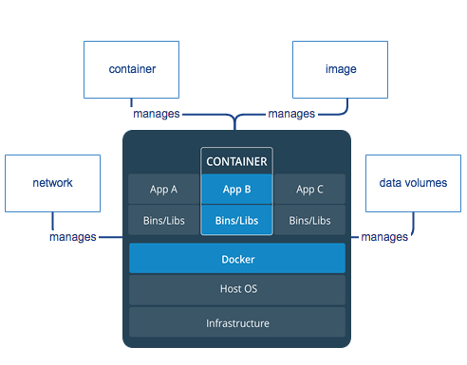
Containers
Feature | Containers
Isolation | Typically provides lightweight isolation from the host and other containers but doesn't provide as strong a security boundary as a virtual machine.
Operating system | Runs the user mode portion of an operating system and can be tailored to contain just the needed services for your app, using fewer system resources.
Deployment | Deploy individual containers by using Docker via command line; deploy multiple containers by using an orchestrator such as Azure Kubernetes Service.
Persistent storage | Use Azure Disks for local storage for a single node, or Azure Files (SMB shares) for storage shared by multiple nodes or servers.
Fault tolerance | If a cluster node fails, any containers running on it are rapidly recreated by the orchestrator on another cluster node.
Notes:
Containers vs Virtual Machines - https://docs.microsoft.com/en-us/virtualization/windowscontainers/about/containers-vs-vm
Application Container Security Guide NIST SP 800-190 https://nvlpubs.nist.gov/nistpubs/SpecialPublications/NIST.SP.800-190.pdf
CIS Guidelines for Kubernetes https://www.cisecurity.org/benchmark/kubernetes/
A container is an isolated, lightweight silo for running an application on the host operating system. Containers build on top of the host operating system's kernel (which can be thought of as the buried plumbing of the operating system and contain only apps and some lightweight operating system APIs and services that run in user mode. While a container shares the host operating system's kernel, the container doesn't get unfettered access to it. Instead, the container gets an isolated–and in some cases virtualized–view of the system. For example, a container can access a virtualized version of the file system and registry, but any changes affect only the container and are discarded when it stops. To save data, the container can mount persistent storage such as an Azure Disk or a file share (including Azure Files).
You need Docker in order to work with Windows Containers. Docker consists of the Docker Engine (dockerd.exe), and the Docker client (docker.exe).
How it works
A container builds on top of the kernel, but the kernel doesn't provide all of the APIs and services an app needs to run–most of these are provided by system files (libraries) that run above the kernel in user mode. Because a container is isolated from the host's user mode environment, the container needs its own copy of these user mode system files, which are packaged into something known as a base image. The base image serves as the foundational layer upon which your container is built, providing it with operating system services not provided by the kernel.
Because containers require far fewer resources (for example, they don't need a full OS), they're easy to deploy and they start fast. This allows you to have higher density, meaning that it allows you to run more services on the same hardware unit, thereby reducing costs.

Slide 47
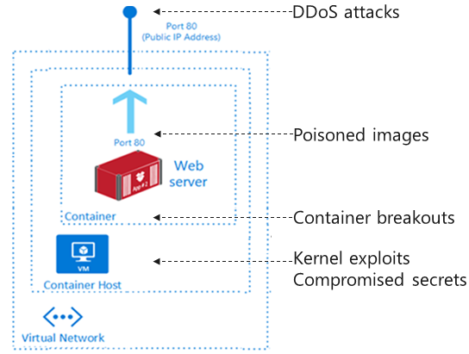
ACI Security
Continuously scan registry images
Use approved images – chain of custody, signing
Run with least privileges
“Allow List” files the container can access
Maintain network segmentation
Monitor and log activities
Notes:
Security considerations for Azure Container Instances - - https://docs.microsoft.com/en-us/azure/container-instances/container-instances-image-security
Security concerns for containers
Containers are not inherently vulnerable. But as with all IT technologies, it’s important to adhere to strict guidelines and procedures for security. The following guidelines and procedures address operational practices more than technical practices.
For example, privilege escalation, repository validation, and image signing represent special threats in the container world. These are new constructs, and people unfamiliar with them might not know the proper way to govern and work with them.
Networking in a container deployment is another special area that needs to be addressed in security scenarios. Unlike VMs, containers have open network traffic across services and a shared kernel—which is a serious security concern. However, you can make the case that VMs are less secure than containers, because breaking applications into microservices with well-defined interfaces and limited, packaged services reduces the overall attack surface. To use containers more safely, you need to be aware of the potential security issues and the major tools and techniques for helping secure container-based systems.
Kernel exploits
Unlike in a VM, all containers and the host share the kernel. This sharing magnifies the importance of any vulnerabilities in the kernel.
Denial of service attacks
All containers share kernel resources. If one container can monopolize access to certain resources—including memory and user IDs—it can deprive the other containers on the host. The result is a DoS, whereby legitimate users are unable to access part or all of the system. For example, repeatedly opening sockets will slow down the entire host machine and eventually cause it to stop working.
Container breakouts
A malicious hacker who gains access to a container shouldn’t be able to gain access to other containers or the host. By default, the container namespace doesn’t include users, so any process that breaks out of the container will have the same privileges on the host as it did in the container. Anyone signed in as a root or a administrator user in the container will thus have root access on the host. You need to prepare for potential privilege escalation attacks—whereby a user gains elevated privileges, such as those of the root user.
Poisoned images
How do you know that the images you’re using have improved safety, haven’t been tampered with, and come from where they claim to come from? If a malicious hacker can trick you into running an image, both the host and your data are will be at risk. Similarly, you want to be sure that the images you’re running are up to date and don’t contain versions of software with known vulnerabilities.

Slide 48
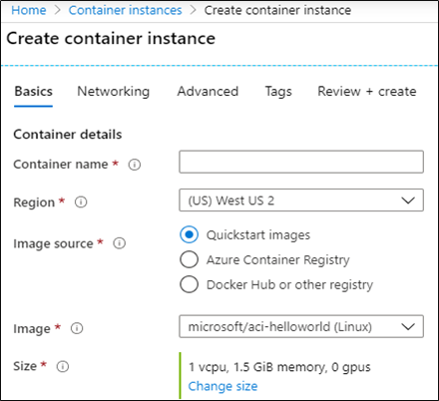
Azure Container Instances (ACI)
PaaS Service
Custom sizes - fast startup times
Public IP connectivity and DNS name
Hypervisor-level security
Isolation features
Co-scheduled groups
Persistent storage
Linux and Windows containers
Virtual network deployments
Notes:
What is Azure Container Instances - https://docs.microsoft.com/en-us/azure/container-instances/container-instances-overview
View the student notes for information about each item.

Slide 49
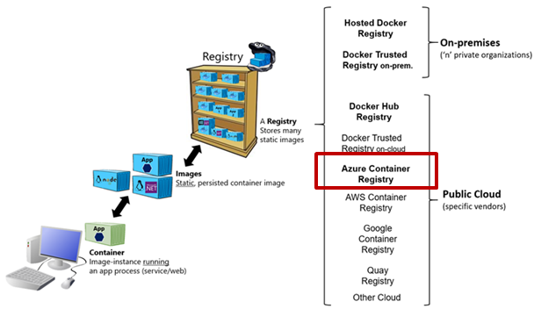
Azure Container Registry (ACR)
Docker registry service
Private and hosted in Azure
Build, store, and manage images
Push and pull with the Docker CLI or the Azure CLI
Access with Azure AD
RBAC to assign permissions
Automate using DevOps
Notes:
Registry
A container registry is a service that stores and distributes container images. Docker Hub is a public container registry that supports the open source community and serves as a general catalog of images. Azure Container Registry provides users with direct control of their images, with integrated authentication, geo-replication supporting global distribution and reliability for network-close deployments, virtual network and firewall configuration, tag locking, and many other enhanced features.
In addition to Docker container images, Azure Container Registry supports related content artifacts including Open Container Initiative (OCI) image formats.
Security and access
You log in to a registry using the Azure CLI or the standard docker login command. Azure Container Registry transfers container images over HTTPS, and supports TLS to secure client connections. Azure Container Registry requires all secure connections from servers and applications to use TLS 1.2. Enable TLS 1.2 by using any recent docker client (version 18.03.0 or later). You control access to a container registry using an Azure identity, an Azure Active Directory-backed service principal, or a provided admin account. Use role-based access control (RBAC) to assign users or systems fine-grained permissions to a registry.
Security features of the Premium SKU include content trust for image tag signing, and firewalls and virtual networks to restrict access to the registry. Azure Security Center optionally integrates with Azure Container Registry to scan images whenever an image is pushed to a registry.
https://docs.microsoft.com/en-us/azure/container-registry/container-registry-intro
Docker overview and About registries, repositories, and images.

Slide 50
ACR Authentication
Require authentication for all operations – unauthenticated access is not supported.
Identity | Usage Scenario | Details
Azure AD identities including user and service principals | Unattended push from DevOps, Unattended pull to Azure or external services | Role-based access – Read, Contributor, Owner
Individual AD identity | Interactive push/pull by developers and testers
Admin user | Interactive push/pull by individual developer or tester | By default, disabled.
Notes:
Authenticate with an Azure container registry - https://docs.microsoft.com/en-us/azure/container-registry/container-registry-authentication
Authenticate with an Azure container registry
There are several ways to authenticate with an Azure container registry, each of which is applicable to one or more registry usage scenarios.
Recommended ways include authenticating to a registry directly via individual login, or your applications and container orchestrators can perform unattended, or "headless," authentication by using an Azure Active Directory (Azure AD) service principal.
Individual login with Azure AD
When working with your registry directly, such as pulling images to and pushing images from a development workstation, authenticate by using the az acr login command in the Azure CLI. When you log in with az acr login, the CLI uses the token created when you executed az login to seamlessly authenticate your session with your registry. To complete the authentication flow, Docker must be installed and running in your environment. az acr login uses the Docker client to set an Azure Active Directory token in the docker.config file. Once you've logged in this way, your credentials are cached, and subsequent docker commands in your session do not require a username or password.
Service principal
If you assign a service principal to your registry, your application or service can use it for headless authentication. Service principals allow role-based access to a registry, and you can assign multiple service principals to a registry. Multiple service principals allow you to define different access for different applications.
The available roles for a container registry include:
AcrPull: pull
AcrPush: pull and push
Owner: pull, push, and assign roles to other users
Admin account
Each container registry includes an admin user account, which is disabled by default. You can enable the admin user and manage its credentials in the Azure portal, or by using the Azure CLI or other Azure tools. The admin account is provided with two passwords, both of which can be regenerated. Two passwords allow you to maintain connection to the registry by using one password while you regenerate the other. If the admin account is enabled, you can pass the username and either password to the docker login command when prompted for basic authentication to the registry.

Slide 51
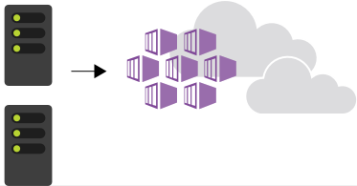
Azure Kubernetes Service (AKS)
Portable, extensible open-source platform for automating deployment, scaling, and the management of containerized workloads.
Fully managed
Dynamic scale containers
Public IP and FQDN (Private IP option)
Automation of rolling updates and rollbacks of containers
Accessed with RBAC or Azure AD
Management of storage, network traffic, and sensitive information
Notes:
Azure Kubernetes Service (AKS) - https://docs.microsoft.com/en-us/azure/aks/intro-kubernetes

Slide 52


AKS Terminology
Pool
Term | Description
Pools | Groups of nodes with identical configurations.
Nodes | Individual VM running containerized applications.
Pods | Single instance of an application. A pod can contain multiple containers.
Deployment | One or more identical pods managed by Kubernetes​.
Manifest | YAML file describing a deployment
Node
Deployment (YAML)
Pod
Pod
Node
Node
Notes:
Kubernetes core concepts for Azure Kubernetes Service (AKS) - https://docs.microsoft.com/en-us/azure/aks/concepts-clusters-workloads
Nodes
An AKS cluster has one or more nodes, which is an Azure virtual machine (VM) that runs the Kubernetes node components and container runtime.
In AKS, the VM image for the nodes in your cluster is currently based on Ubuntu Linux. When you create an AKS cluster or scale up the number of nodes, the Azure platform creates the requested number of VMs and configures them. There is no manual configuration for you to perform.
Node pools
Nodes of the same configuration are grouped together into node pools. A Kubernetes cluster contains one or more node pools. The initial number of nodes and size are defined when you create an AKS cluster, which creates a default node pool. This default node pool in AKS contains the underlying VMs that run your agent nodes.
Pods
Kubernetes uses pods to run an instance of your application. A pod represents a single instance of your application. Pods typically have a 1:1 mapping with a container, although there are advanced scenarios where a pod may contain multiple containers. These multi-container pods are scheduled together on the same node, and allow containers to share related resources.
A pod is a logical resource, but the container(s) are where the application workloads run. Pods are typically ephemeral, disposable resources, and individually scheduled pods miss some of the high availability and redundancy features that Kubernetes provides. Instead, pods are usually deployed and managed by Kubernetes Controllers, such as the Deployment Controller.
Manifests
A YAML file describing a deployment.
Deployments
A deployment represents one or more identical pods, managed by the Kubernetes Deployment Controller. A deployment defines the number of replicas (pods) to create, and the Kubernetes Scheduler ensures that if pods or nodes encounter problems, additional pods are scheduled on healthy nodes.
You can update deployments to change the configuration of pods, container image used, or attached storage. The Deployment Controller drains and terminates a given number of replicas, creates replicas from the new deployment definition, and continues the process until all replicas in the deployment are updated.

Slide 53
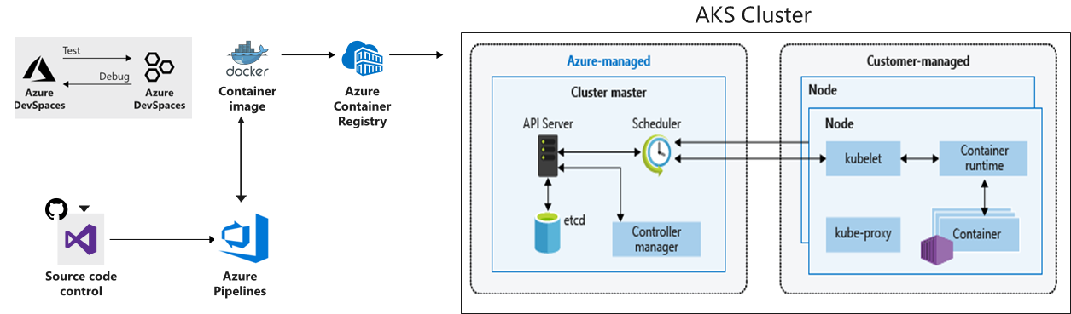
AKS Architecture
Azure-managed cluster master nodes provide the core Kubernetes services and orchestration of application workloads
Customer-managed nodes (virtual machines) run your application workloads
Notes:
Kubernetes core concepts for Azure Kubernetes Service (AKS) - https://docs.microsoft.com/en-us/azure/aks/concepts-clusters-workloads
Master security
In AKS, the Kubernetes master components are part of the managed service provided by Microsoft. Each AKS cluster has its own single-tenanted, dedicated Kubernetes master to provide the API Server, Scheduler, etc. This master is managed and maintained by Microsoft.
By default, the Kubernetes API server uses a public IP address and a fully qualified domain name (FQDN). You can control access to the API server using Kubernetes role-based access controls and Azure Active Directory.
In a private cluster, the control plane or API server has internal IP addresses.
https://docs.microsoft.com/en-us/azure/aks/private-clusters
Node security
AKS nodes are Azure virtual machines that you manage and maintain. Linux nodes run an optimized Ubuntu distribution using the Moby container runtime. Windows Server nodes run an optimized Windows Server 2019 release and also use the Moby container runtime. When an AKS cluster is created or scaled up, the nodes are automatically deployed with the latest OS security updates and configurations.
The Azure platform automatically applies OS security patches to Linux nodes on a nightly basis. If a Linux OS security update requires a host reboot, that reboot is not automatically performed. You can manually reboot the Linux nodes, or a common approach is to use Kured, an open-source reboot daemon for Kubernetes. Kured runs as a DaemonSet and monitors each node for the presence of a file indicating that a reboot is required. Reboots are managed across the cluster using the same cordon and drain process as a cluster upgrade.
For Windows Server nodes, Windows Update does not automatically run and apply the latest updates. On a regular schedule around the Windows Update release cycle and your own validation process, you should perform an upgrade on the Windows Server node pool(s) in your AKS cluster. This upgrade process creates nodes that run the latest Windows Server image and patches, then removes the older nodes. Nodes are deployed into a private virtual network subnet, with no public IP addresses assigned. For troubleshooting and management purposes, SSH is enabled by default. This SSH access is only available using the internal IP address.
To provide storage, the nodes use Azure Managed Disks. For most VM node sizes, these are Premium disks backed by high-performance SSDs. The data stored on managed disks is automatically encrypted at rest within the Azure platform. To improve redundancy, these disks are also securely replicated within the Azure datacenter.
Kubernetes environments, in AKS or elsewhere, currently aren't completely safe for hostile multi-tenant usage. Additional security features such as Pod Security Policies or more fine-grained role-based access controls (RBAC) for nodes make exploits more difficult. However, for true security when running hostile multi-tenant workloads, a hypervisor is the only level of security that you should trust. The security domain for Kubernetes becomes the entire cluster, not an individual node. For these types of hostile multi-tenant workloads, you should use physically isolated cluster
To protect your customer data as you run application workloads in Azure Kubernetes Service (AKS), the security of your cluster is a key consideration.

Slide 54

AKS Networking
Internal traffic
Cluster IP
Pod
Incoming direct traffic
NodePort
Pod
AKS node
Pod
Pod
Incoming non-direct traffic
e
AKS node
Load Balancer
Pods run an instance of your application
NodePort provides mapping for incoming direct traffic
Services group pods together to provide network connectivity
Load balancer has external IP address for incoming non-direct traffic
Cluster IP provides internal traffic access
Notes:
To allow access to your applications, or for application components to communicate with each other, Kubernetes provides an abstraction layer to virtual networking. Kubernetes nodes are connected to a virtual network and can provide inbound and outbound connectivity for pods. The kube-proxy component runs on each node to provide these network features.
In Kubernetes, Services logically group pods to allow for direct access via an IP address or DNS name and on a specific port. You can also distribute traffic using a load balancer. More complex routing of application traffic can also be achieved with Ingress Controllers. Security and filtering of the network traffic for pods is possible with Kubernetes network policies.
The Azure platform also helps to simplify virtual networking for AKS clusters. When you create a Kubernetes load balancer, the underlying Azure load balancer resource is created and configured. As you open network ports to pods, the corresponding Azure network security group rules are configured. For HTTP application routing, Azure can also configure external DNS as new ingress routes are configured.
Services
To simplify the network configuration for application workloads, Kubernetes uses Services to logically group a set of pods together and provide network connectivity. The following Service types are available:
Cluster IP - Creates an internal IP address for use within the AKS cluster. Good for internal-only applications that support other workloads within the cluster.
NodePort - Creates a port mapping on the underlying node that allows the application to be accessed directly with the node IP address and port.
LoadBalancer - Creates an Azure load balancer resource, configures an external IP address, and connects the requested pods to the load balancer backend pool. To allow customers' traffic to reach the application, load balancing rules are created on the desired ports.
ExternalName - Creates a specific DNS entry for easier application access.
When you run modern, microservices-based applications in Kubernetes, you often want to control which components can communicate with each other. The principle of least privilege should be applied to how traffic can flow between pods in an Azure Kubernetes Service (AKS) cluster. Let's say you likely want to block traffic directly to back-end applications. The Network Policy feature in Kubernetes lets you define rules for ingress and egress traffic between pods in a cluster.

Slide 55
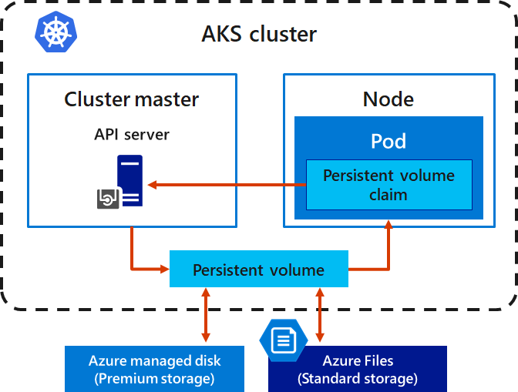
AKS Storage
Local storage on the node is fast and simple to use
Local storage might not be available after the pod is deleted
Multiple pods may share data volumes
Storage could potentially be reattached to another pod

Slide 56
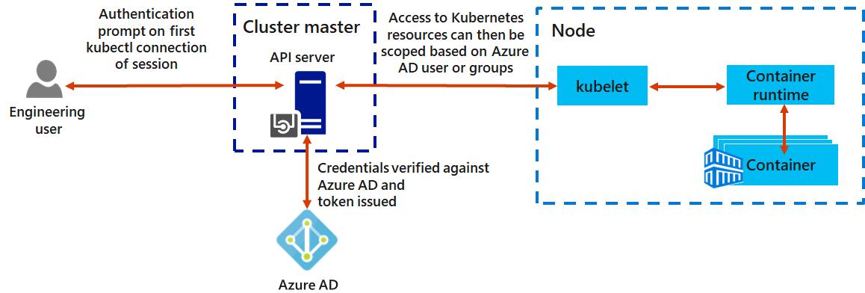
AKS and Azure Active Directory
Use Azure AD as an integrated identity solution
Use service accounts, user accounts, and role-based access control
Notes:
Integrate Azure Active Directory with Azure Kubernetes Service - https://docs.microsoft.com/en-us/azure/aks/azure-ad-integration
Service principals with Azure Kubernetes Service (AKS) - https://docs.microsoft.com/en-us/azure/aks/kubernetes-service-principal
Use managed identities in Azure Kubernetes Service - https://docs.microsoft.com/en-us/azure/aks/use-managed-identity
There are different ways to authenticate with and secure Kubernetes clusters. Using role-based access controls (RBAC), you can grant users or groups access to only the resources they need. With Azure Kubernetes Service (AKS), you can further enhance the security and permissions structure by using Azure Active Directory. These approaches help you secure your application workloads and customer data.
Kubernetes service accounts
One of the primary user types in Kubernetes is a service account. A service account exists in, and is managed by, the Kubernetes API. The credentials for service accounts are stored as Kubernetes secrets, which allows them to be used by authorized pods to communicate with the API Server. Most API requests provide an authentication token for a service account or a normal user account.
Normal user accounts allow more traditional access for human administrators or developers, not just services and processes. Kubernetes itself doesn't provide an identity management solution where regular user accounts and passwords are stored. Instead, external identity solutions can be integrated into Kubernetes. For AKS clusters, this integrated identity solution is Azure Active Directory.
Azure Active Directory integration
The security of AKS clusters can be enhanced with the integration of Azure Active Directory (AD). Built on decades of enterprise identity management, Azure AD is a multi-tenant, cloud-based directory, and identity management service that combines core directory services, application access management, and identity protection. With Azure AD, you can integrate on-premises identities into AKS clusters to provide a single source for account management and security.
With Azure AD-integrated AKS clusters, you can grant users or groups access to Kubernetes resources within a namespace or across the cluster. To obtain a kubectl configuration context, a user can run the az aks get-credentials command. When a user then interacts with the AKS cluster with kubectl, they are prompted to sign in with their Azure AD credentials. This approach provides a single source for user account management and password credentials. The user can only access the resources as defined by the cluster administrator.
Azure AD authentication in AKS clusters uses OpenID Connect, an identity layer built on top of the OAuth 2.0 protocol. OAuth 2.0 defines mechanisms to obtain and use access tokens to access protected resources, and OpenID Connect implements authentication as an extension to the OAuth 2.0 authorization process.

Slide 57
Additional Study – Container Security
Module Review Questions
Microsoft Learn Modules (docs.microsoft.com/Learn)
Core Cloud Services - Azure compute options
Build and store container images with Azure Container Registry (Exercise)
Build a containerized web application with Docker (Exercise)
Introduction to Docker containers
Run Docker containers with Azure Container Instances (Exercise)
Azure Kubernetes Service Workshop (Exercise)
Notes:
For students who may be new to Azure or are struggling with the labs consider having them use their lab time going through the Learn modules instead.
(docs.microsoft.com/Learn)
Core Cloud Services - Azure compute options – https://docs.microsoft.com/en-us/learn/modules/intro-to-azure-compute/
Build and store container images with Azure Container Registry - https://docs.microsoft.com/en-us/learn/modules/build-and-store-container-images/
Build a containerized web application with Docker - https://docs.microsoft.com/en-us/learn/modules/intro-to-containers/
Introduction to Docker containers - https://docs.microsoft.com/en-us/learn/modules/intro-to-docker-containers/
Run Docker containers with Azure Container Instances - https://docs.microsoft.com/en-us/learn/modules/run-docker-with-azure-container-instances/
Azure Kubernetes Service Workshop - https://docs.microsoft.com/en-us/learn/modules/aks-workshop/

Slide 58
Module Labs

Slide 59



Lab 07 – Network and Application Security Groups
Create application security groups
User
Admin
(RDP)
Wrap the ASGs with a Network Security Group (NSG)
NSG
Use NSG rules to route traffic:
Admins can RDP to the management servers but not the web servers
Users can access the web servers and see the default IIS page
ASG
ASG
Web Servers
Management Servers
Notes:
Lab scenario
You have been asked to implement your organization's virtual networking infrastructure and test to ensure it is working correctly. In particular:
The organization has two groups of servers: Web Servers and Management Servers.
Each group of servers should be in its own Application Security Group.
You should be able to RDP into the Management Servers, but not the Web Servers.
The Web Servers should display the IIS web page when accessed from the internet.
Network security group rules should be used to control network access.
For all the resources in this lab, we are using the East US region. Verify with your instructor this is the region to use for class.
Lab exercises
In this lab, you will complete the following exercises:
Exercise 1: Create the virtual networking infrastructure
Exercise 2: Deploy virtual machines and test the network filters

Slide 60






Lab 07 – Network and Application Security Groups
Exercise1, Task1
AZ500LAB07
myVirtualNetwork 10.0.0.0/16
Exercise1, Task3, Task4
default 10.0.0.0/24
myNsg
Exercise2, Task1
Exercise1, Task2
Exercise2, Task3
Exercise2, Task4
HTTP/HTTPS
myAsgWebServers
myVmWeb
10.0.0.4
Your PC
RDP
Exercise2, Task2
Exercise2, Task3
myAsgMgmtServers
myVMMgmt
10.0.0.5

Slide 61
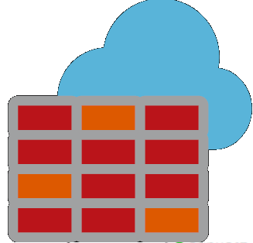
Lab 08 – Azure Firewall
Create a Workload subnet and Jump subnet each with a virtual machine
DNS Lookup
Bing
Create a custom route to ensure outbound traffic from the workload subnet goes to the firewall
Network rule
Application rule
Create firewall application rules to allow traffic to Bing
Custom route
Create firewall network rules to allow traffic to DNS lookup servers
Subnet
Subnet
Jump Server
Workload Servers
Notes:
Lab scenario
You have been asked to install Azure Firewall. This will help your organization control inbound and outbound network access which is an important part of an overall network security plan. Specifically, you would like to create and test the following infrastructure components:
A virtual network with a workload subnet and a jump host subnet.
A virtual machine is each subnet.
A custom route that ensures all outbound workload traffic from the workload subnet must use the firewall.
Firewall Application rules that only allow outbound traffic to www.bing.com.
Firewall Network rules that allow external DNS server lookups.
For all the resources in this lab, we are using the East US region. Verify with your instructor this is the region to use for class.
Lab exercises
Exercise 1: Deploy and test an Azure Firewall

Slide 62



Lab 08 – Azure Firewall
Exercise1, Task1
AZ500LAB08
Test-FW-VN 10.0.0.0/16
TEST-FW-PIP
Exercise1, Task3
Firewall-route
Test-FW01
10.0.1.4
AzureFirewallSubnet 10.0.1.0/24
Exercise1, Task7
Exercise1, Task6
Configure the virtual machine DNS servers
Srv-Work
10.0.2.4
Srv-Jump 10.0.3.4
Srv-Jump-PIP
Your PC
Workload-SN 10.0.2.0/24
Jump-SN 10.0.3.0/24

Slide 63


Lab 09 – Configuring and Securing ACR and AKS
Create an Azure Container Registry
...
Azure Container Registry
Create a Dockerfile, build a container and push it to ACR
Dockerfile
Create an Azure Kubernetes Service
Externally-facing container
Give AKS permission to access the ACR
Internally-facing container
Deploy an external facing container and test
Deploy an internal facing container and test
AKS Cluster
Notes:
Lab scenario
You have been asked to deploy a proof of concept with Azure Container Registry and Azure Kubernetes Service. Specifically, the proof of concept should demonstrate:
Using Dockerfile to build an image.
Using Azure Container Registry to store images.
Configuring an Azure Kubernetes Service.
Securing and accessing container applications both internally and externally.
Lab exercises
Exercise 1: Configuring and Securing ACR and AKS

Slide 64


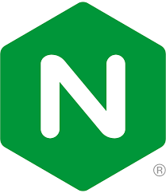


Lab 09 – Configuring and Securing ACR and AKS
Exercise1, Task1
Exercise1, Task2
AZ500LAB09
AZ500xxxx
Docker File
Exercise1, Task4
AcrPull
Exercise1, Task3
MyKubernetesCluster
Exercise1, Task5, Task6, Task7, Task8
nginxexternal
nginxinternal

Slide 65
End of presentation

